Slide 1

Will it rain tomorrow?
Machine Learning Project
Kelvin, Lillian, Michael, Lois

Slide 2
01
02
Project Aims
Data Preprocessing
03
04
Modelling
Conclusion
Purpose and business value of this project
EDA, imputation, encoding, feature scaling
Logistic regression, random forest, decision tree, SVM
Model evaluation and future plans

Slide 3
01
Project Aims

Slide 4
Purpose
Business Value
Build a binary classification model capable
of accurately predicting rainfall
Determine the best algorithm by evaluating accuracy and variance of different models
Major Australian industries of aviation, tourism and agriculture are especially sensitive to the weather
Accurate weather forecasting is essential to these businesses as it allows for better preparation: increasing profits, reducing losses and protecting property
Notes:
Aviation: icing due to the heavy precipitation
Tourism: outdoor activities are severely curtailed by heavy rain
Agriculture: Farmers rely on weather forecasts to decide what work to do on any particular day. For example, drying hay is only feasible in dry weather.
Commercial: shops may change the stocks on their shelves in anticipation of different consumer spending habits in different weather conditions

Slide 5
02
Data Preprocessing

Slide 6
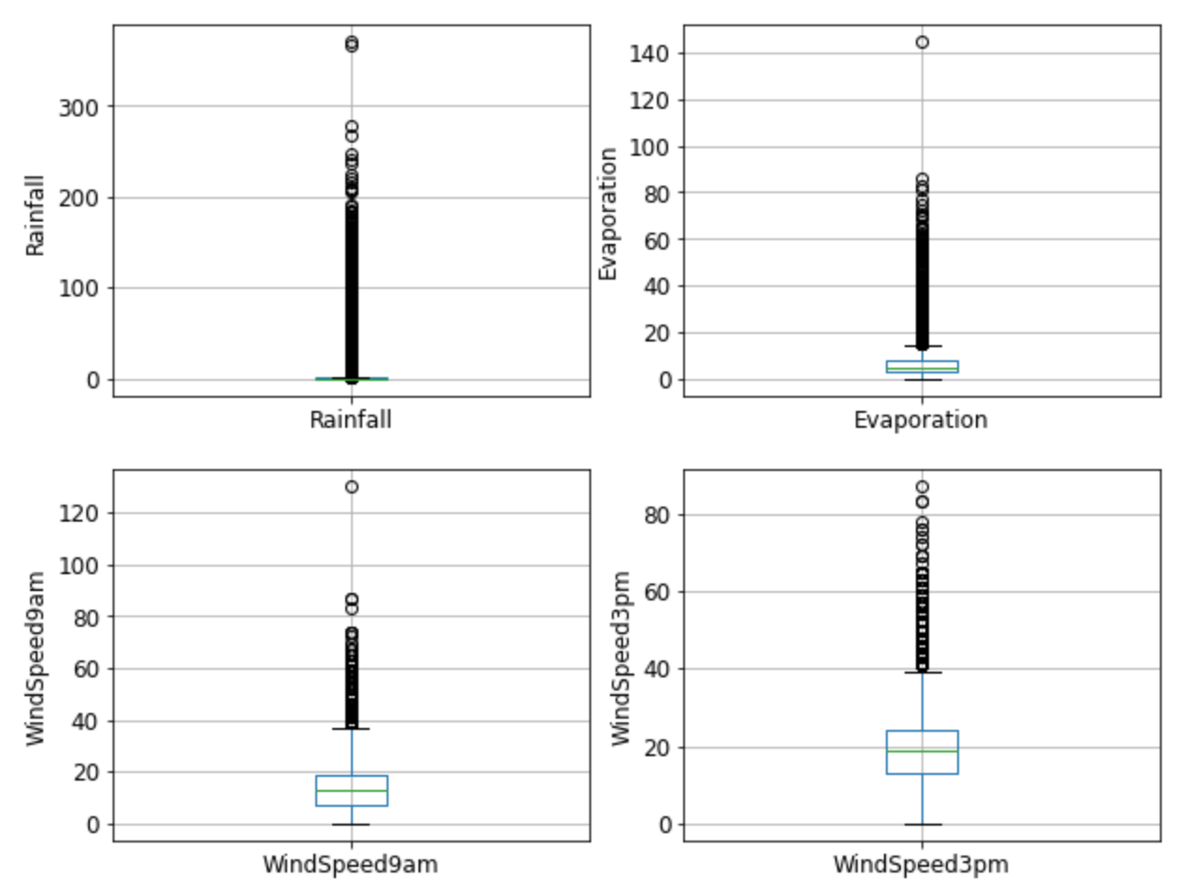
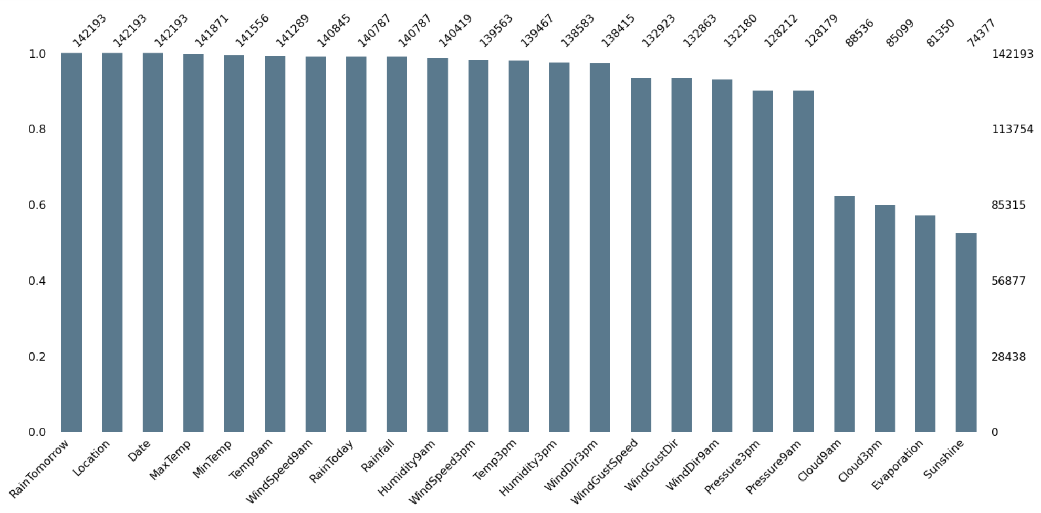
Exploratory Data Analysis

Slide 7
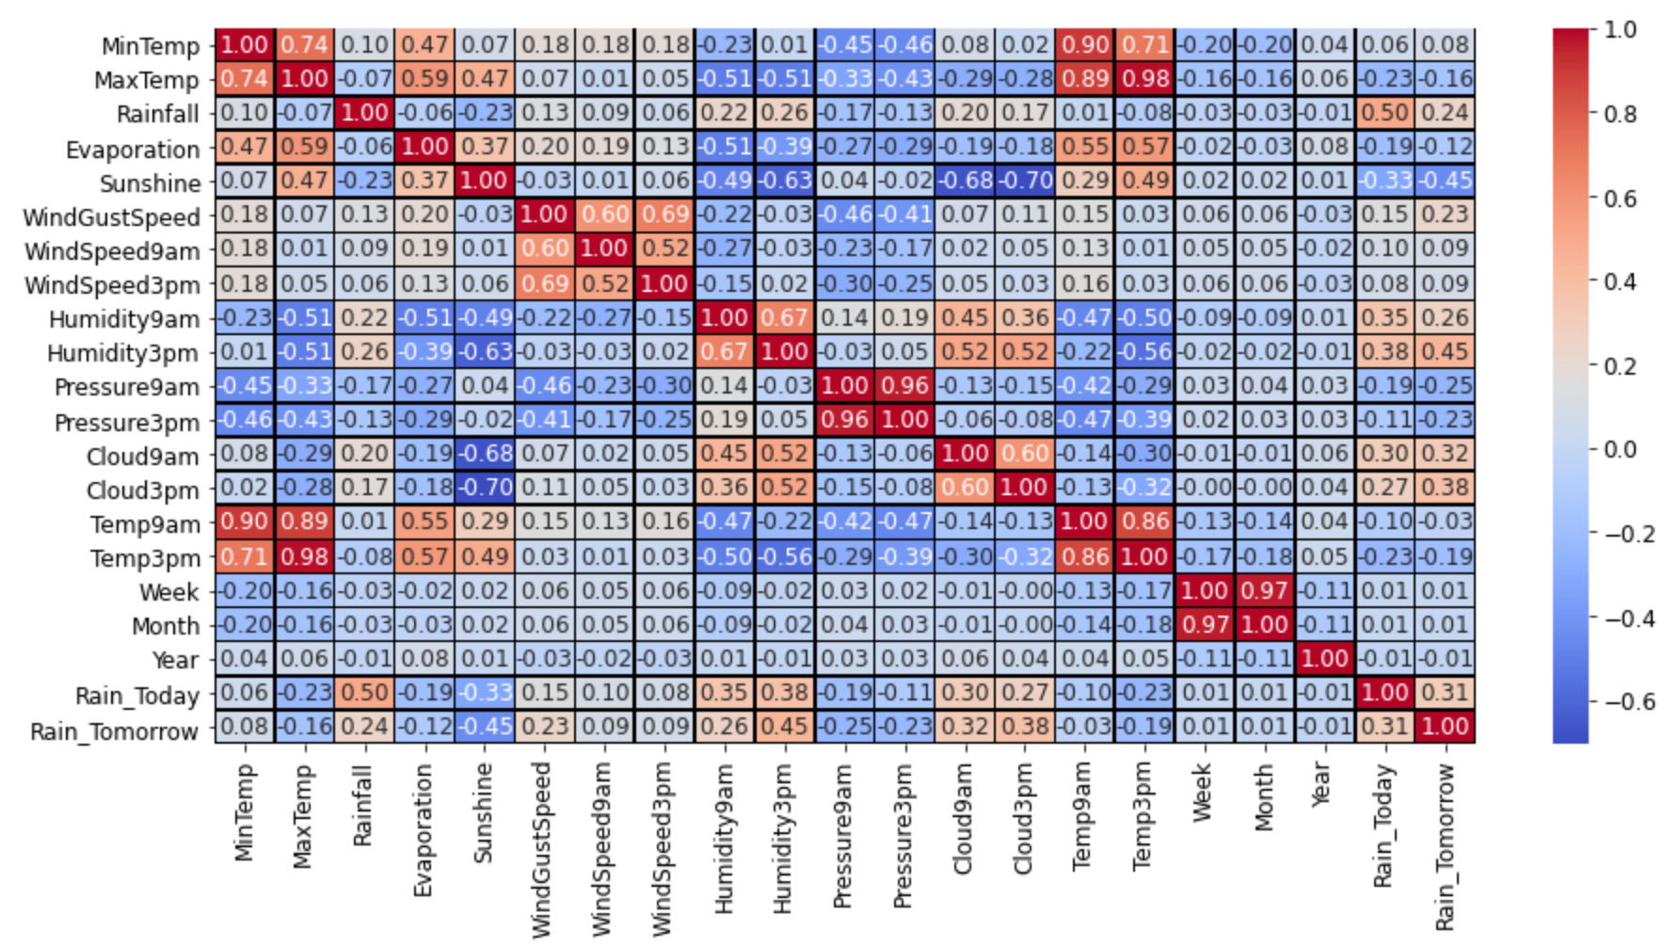
Exploratory Data Analysis

Slide 8
Feature Engineering
Data Split
Encoding
TrainTestSplit before feature engineering to prevent data leakage
Categorical data converted to numerical data using One-hot encoding
1
2
3
2
Imputation
Scaling
Missing values imputed with median for numerical data; mode for categorical data
Standardisation of features using StandardScaler

Slide 9
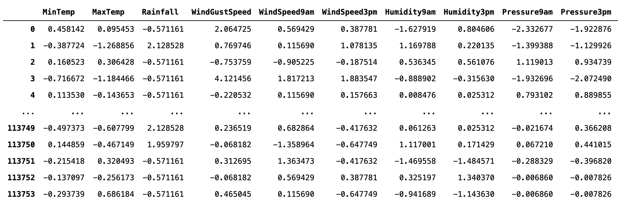
Dataset

Slide 10
03
Modelling

Slide 11
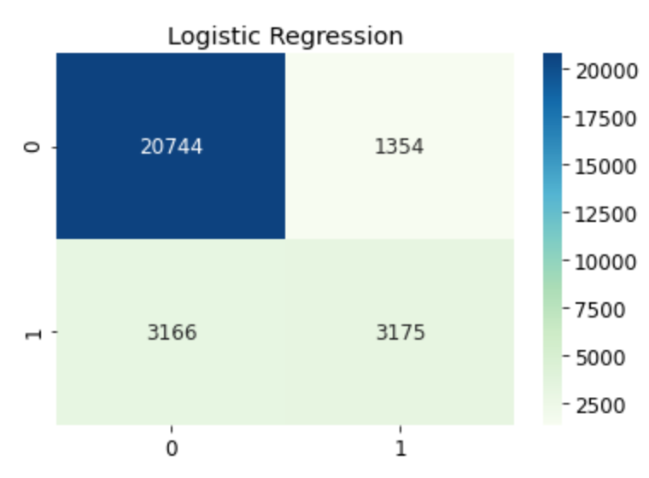
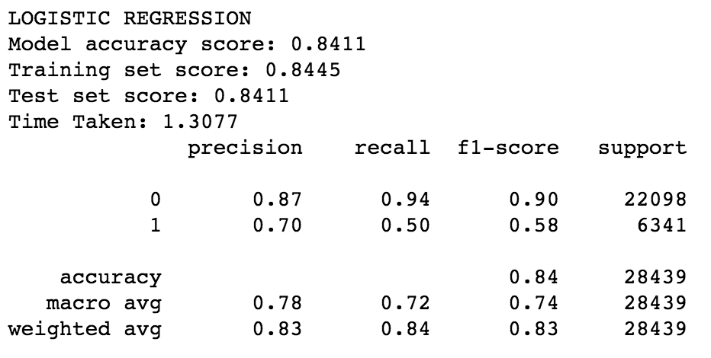
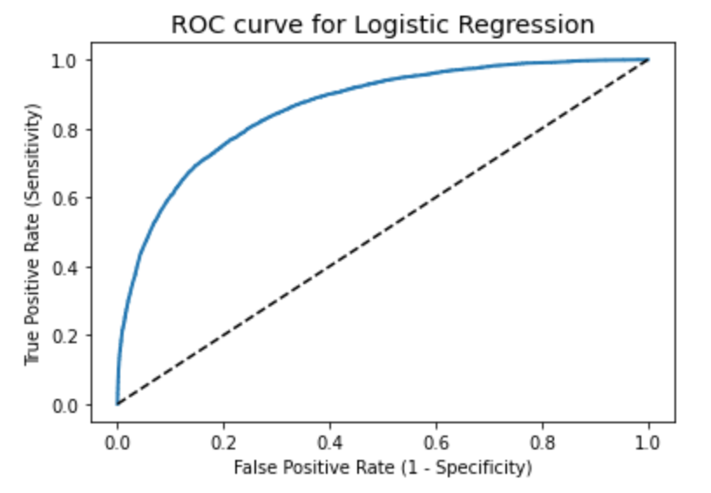
Logistic Regression

Slide 12
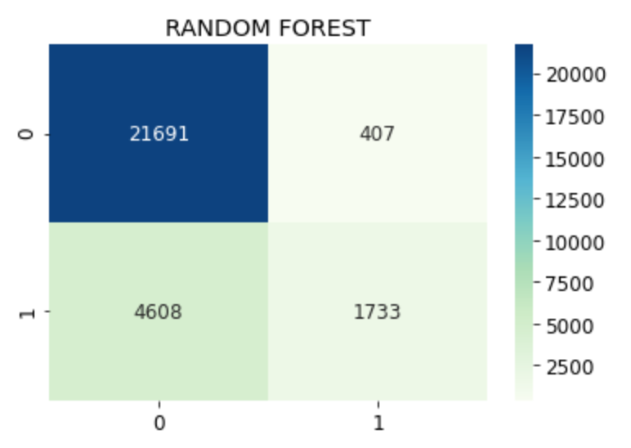
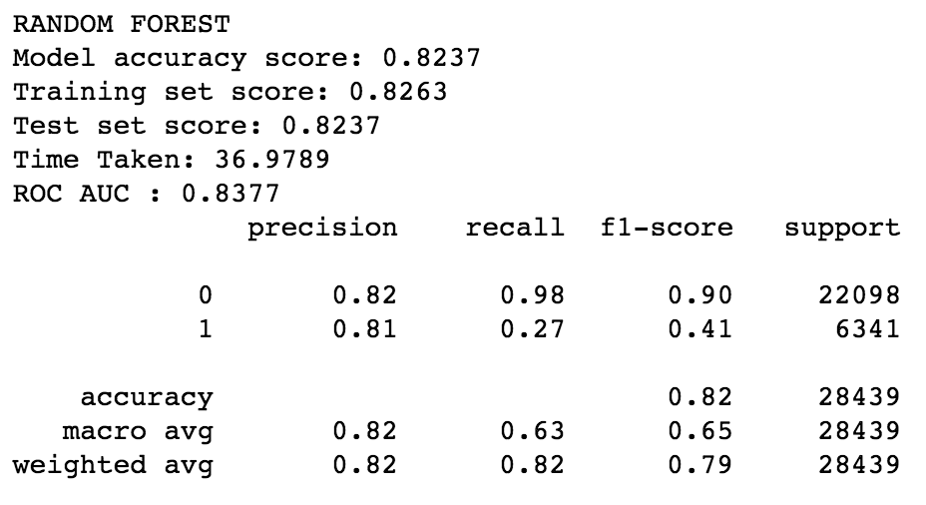
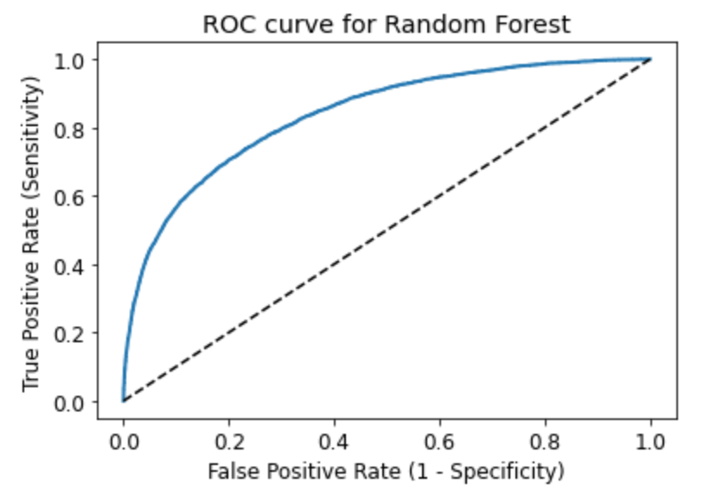
Random Forest

Slide 13
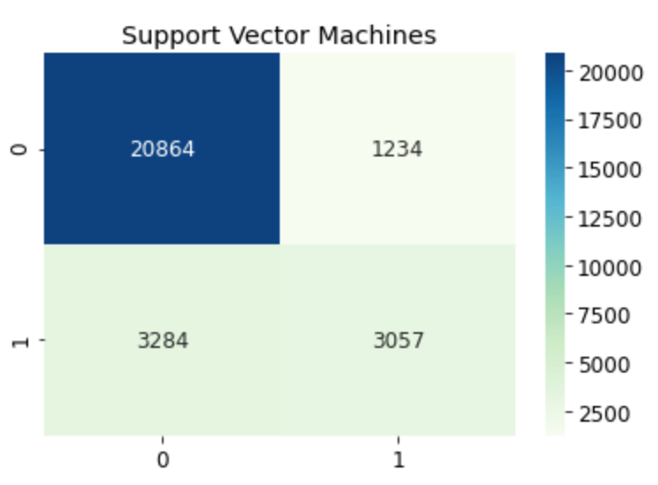
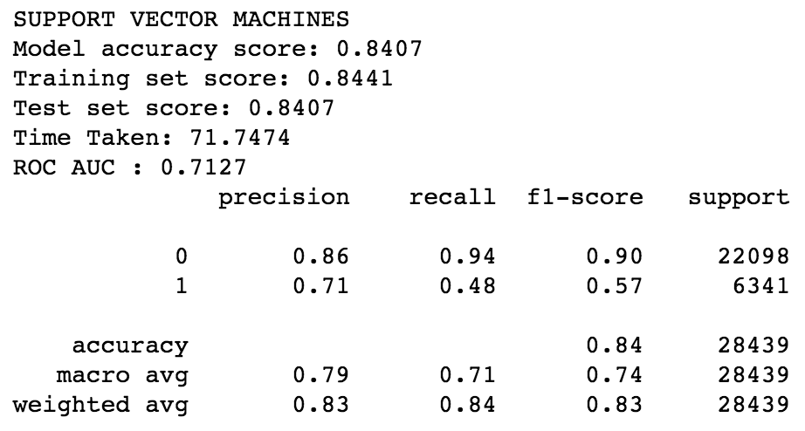
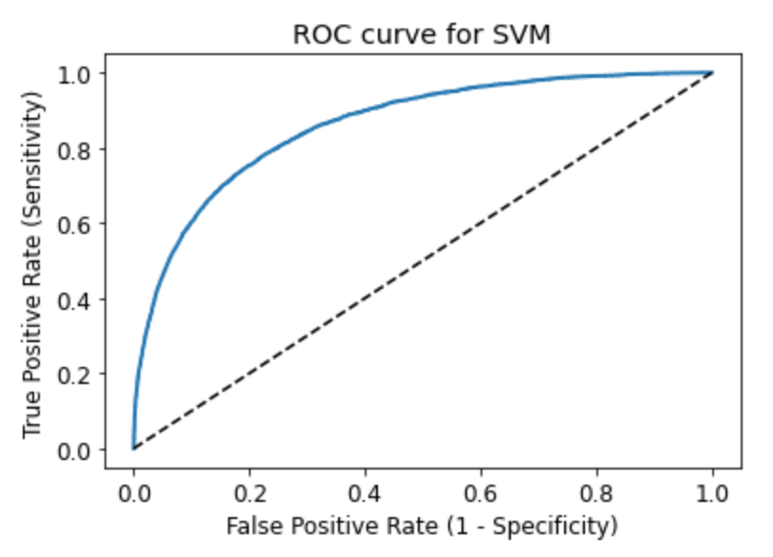
Support Vector Machines (SVM)

Slide 14
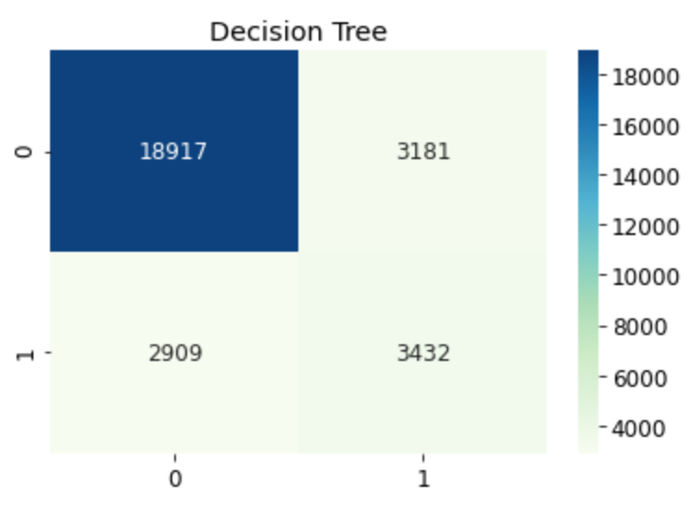
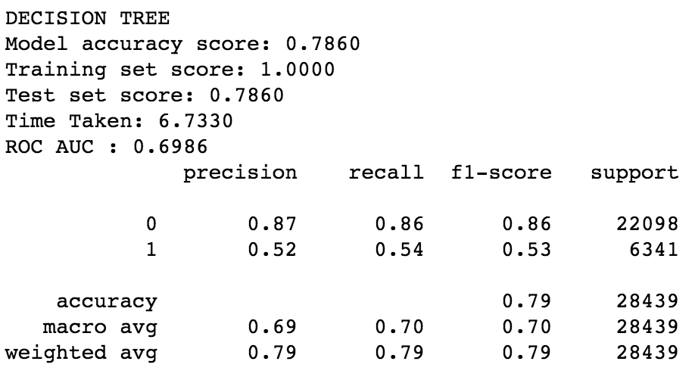
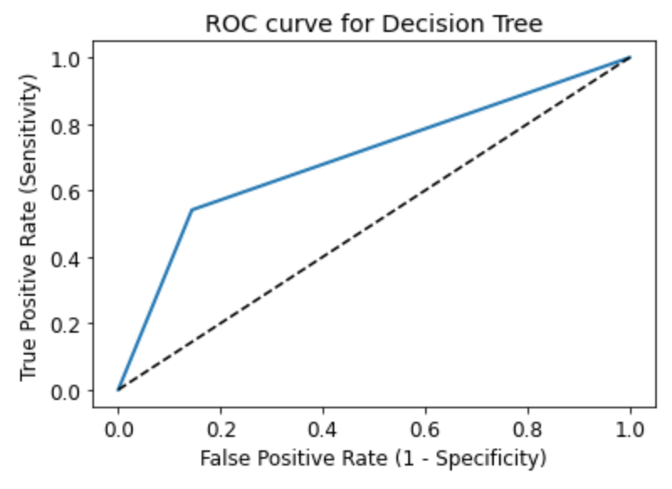
Decision Tree

Slide 15
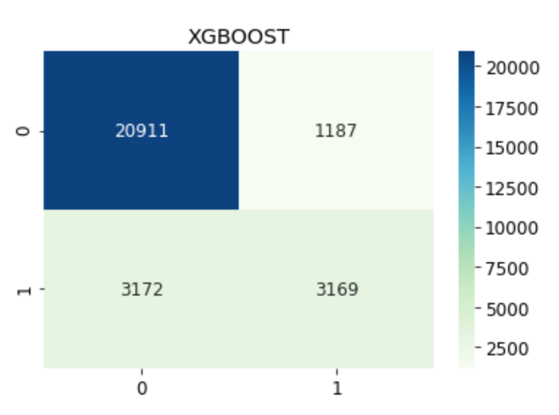
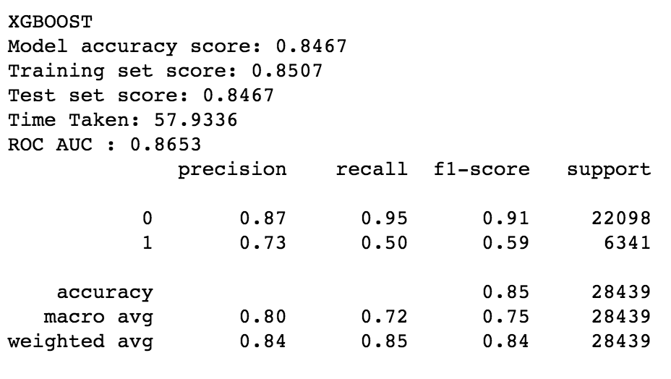
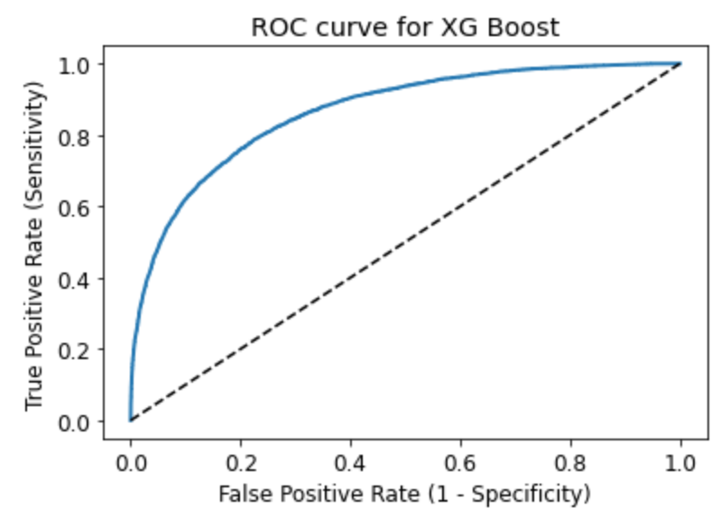
XGBoost

Slide 16
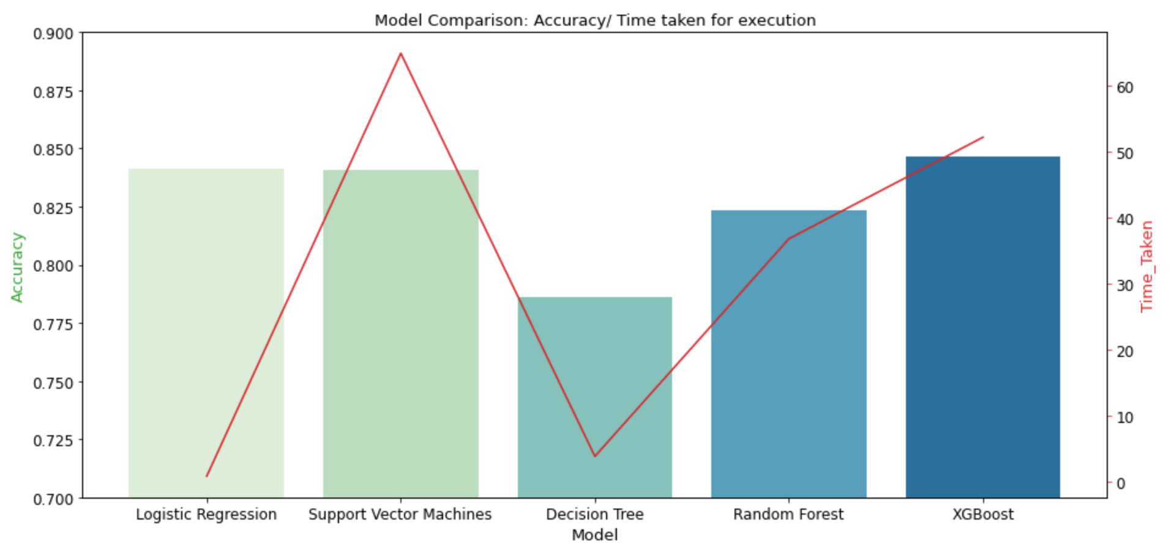
Comparison

Slide 17
04
Conclusion

Slide 18
Model Evaluation
XG Boost
Logistic Regression
Accuracy: 0.8467
Train vs. test score delta: 0.0040
Time taken: 57.9s
Random Forest
Accuracy: 0.8411
Train vs. test score delta: 0.0034
Time taken: 1.3s
Accuracy: 0.8237
Train vs. test score delta: 0.0026
Time taken: 37.0s
2
1
3

Slide 19
In the future...
Increasing range of forecast
Implement deep learning methods
Forecasting volume
of rain

